Slide 1
Context-Free Languages
Fall 2006
Costas Busch - RPI

Slide 2
Context-Free Grammars
Fall 2006
Costas Busch - RPI

Slide 3

Grammars
Grammars express languages
Example: the English language grammar
Fall 2006
Costas Busch - RPI

Slide 4
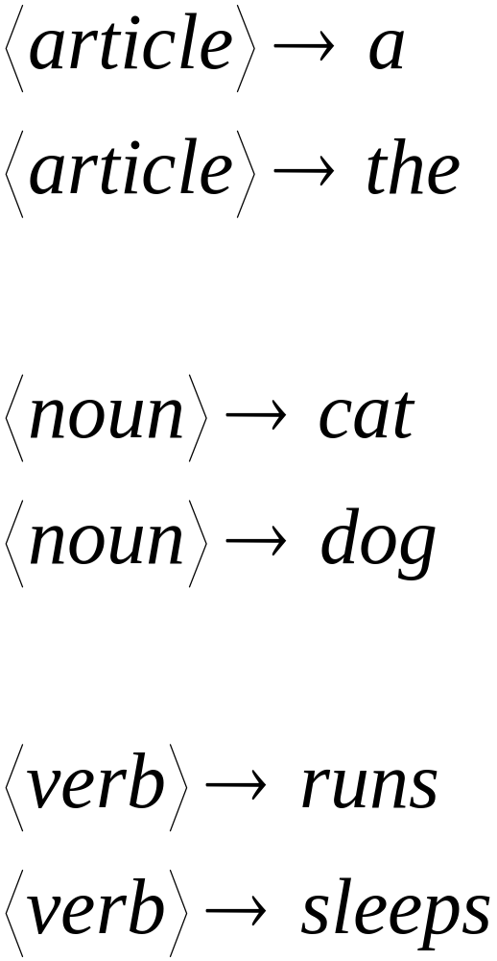
Fall 2006
Costas Busch - RPI

Slide 5
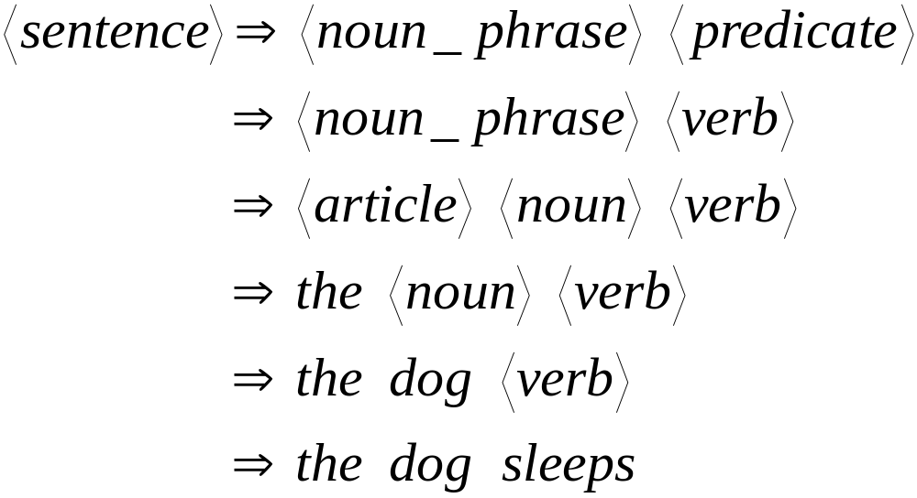
Derivation of string “the dog walks”:
Fall 2006
Costas Busch - RPI

Slide 6
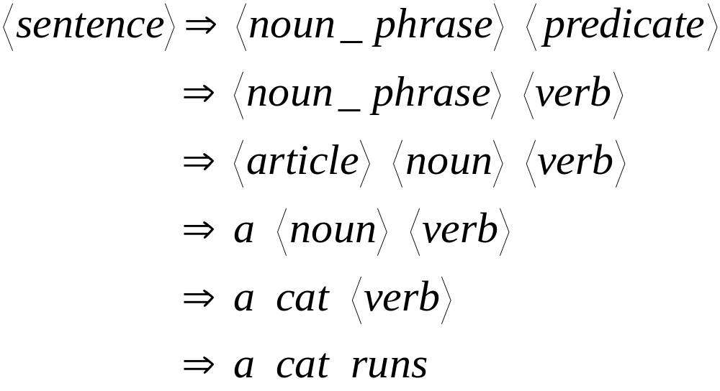
Derivation of string “a cat runs”:
Fall 2006
Costas Busch - RPI

Slide 7
Language of the grammar:
L = { “a cat runs”,
“a cat sleeps”,
“the cat runs”,
“the cat sleeps”,
“a dog runs”,
“a dog sleeps”,
“the dog runs”,
“the dog sleeps” }
Fall 2006
Costas Busch - RPI

Slide 8
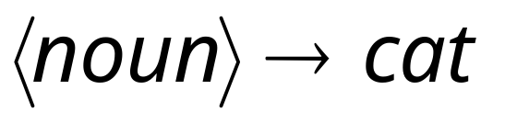
Productions
Sequence of
Terminals (symbols)
Variables
Sequence of Variables
Fall 2006
Costas Busch - RPI

Slide 9


Another Example
Sequence of
terminals and variables
Grammar:
Variable
The right side
may be
Fall 2006
Costas Busch - RPI

Slide 10




Grammar:
Derivation of string :
Fall 2006
Costas Busch - RPI

Slide 11



Grammar:
Derivation of string :
Fall 2006
Costas Busch - RPI

Slide 12

Grammar:
Other derivations:
Fall 2006
Costas Busch - RPI

Slide 13

Grammar:
Language of the grammar:
Fall 2006
Costas Busch - RPI

Slide 14

A Convenient Notation
We write:
Instead of:
for zero or more derivation steps
Fall 2006
Costas Busch - RPI

Slide 15

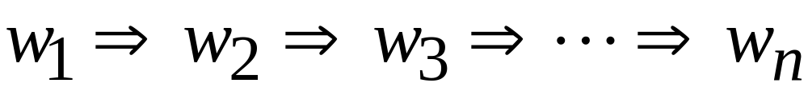
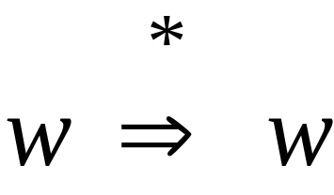
In general we write:
If:
in zero or more derivation steps
Trivially:
Fall 2006
Costas Busch - RPI

Slide 16
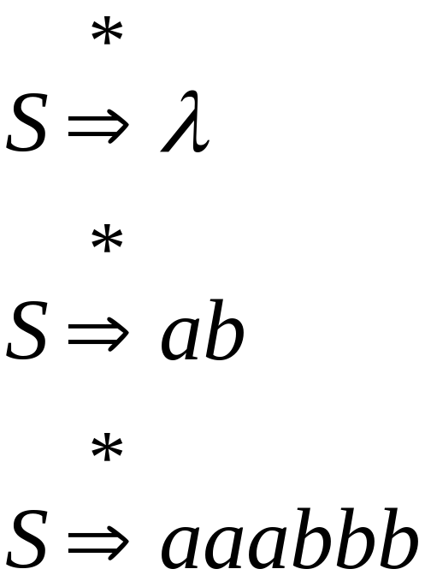
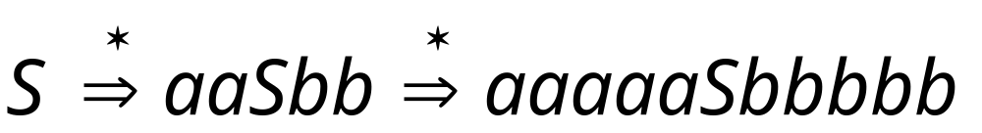
Example Grammar
Possible Derivations
Fall 2006
Costas Busch - RPI

Slide 17
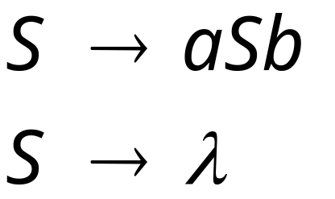
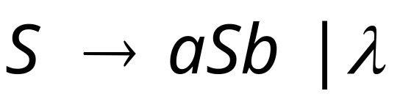
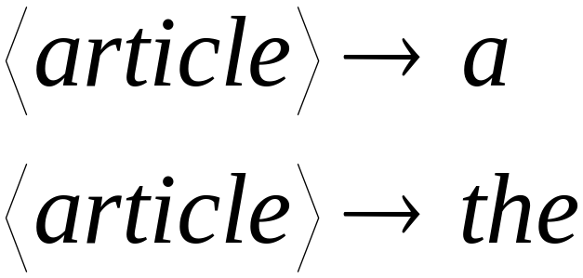
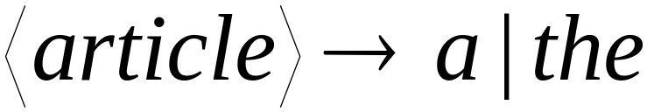
Another convenient notation:
Fall 2006
Costas Busch - RPI

Slide 18

Formal Definitions
Grammar:
Set of
variables
Set of
terminal
symbols
Start
variable
Set of
productions
Fall 2006
Costas Busch - RPI

Slide 19


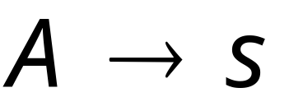
Context-Free Grammar:
All productions in are of the form
Variable
String of
variables and
terminals
Fall 2006
Costas Busch - RPI

Slide 20




Example of Context-Free Grammar
productions
start variable
variables
terminals
Fall 2006
Costas Busch - RPI

Slide 21




Language of a Grammar:
For a grammar with start variable
String of terminals or
Fall 2006
Costas Busch - RPI

Slide 22
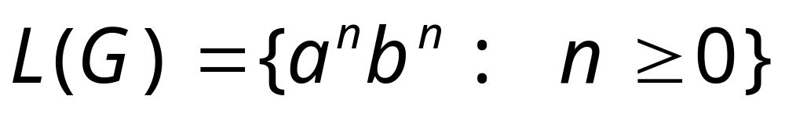
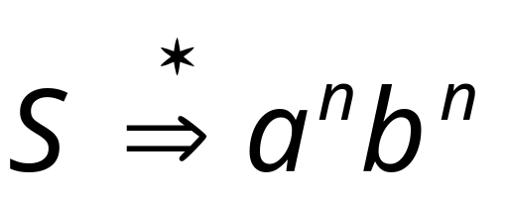
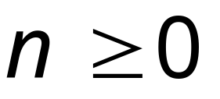
Example:
context-free grammar :
Since, there is derivation
for any
Fall 2006
Costas Busch - RPI

Slide 23

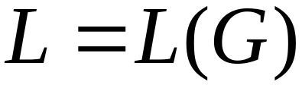
Context-Free Language:
A language is context-free
if there is a context-free grammar
with
Fall 2006
Costas Busch - RPI

Slide 24
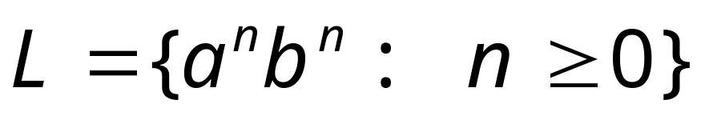
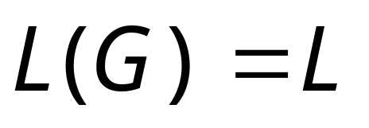
Example:
is a context-free language
since context-free grammar :
generates
Fall 2006
Costas Busch - RPI

Slide 25
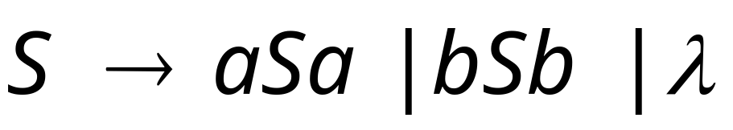


Another Example
Context-free grammar :
Example derivations:
Palindromes of even length
Fall 2006
Costas Busch - RPI

Slide 26
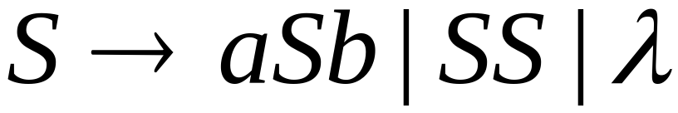
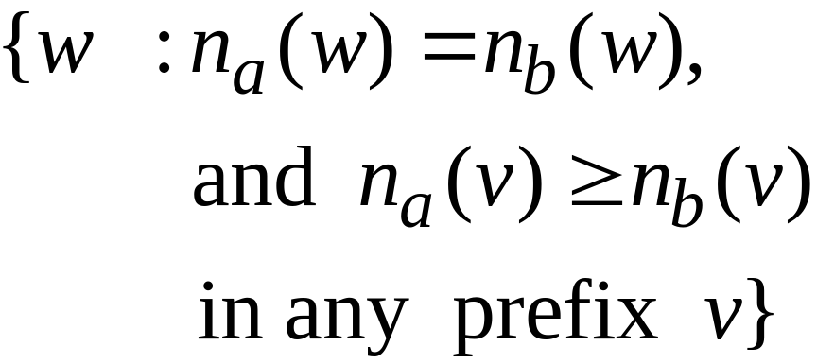

Another Example
Context-free grammar :
Example derivations:
Describes
matched
parentheses:
() ((( ))) (( ))
Fall 2006
Costas Busch - RPI

Slide 27
Derivation Order and
Derivation Trees
Fall 2006
Costas Busch - RPI

Slide 28
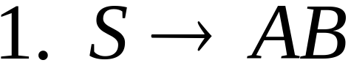
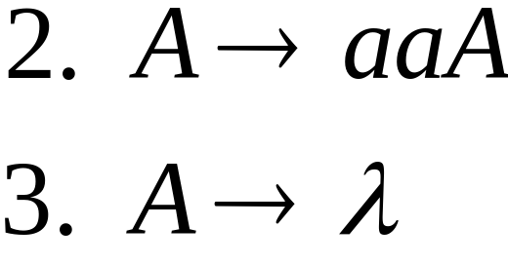
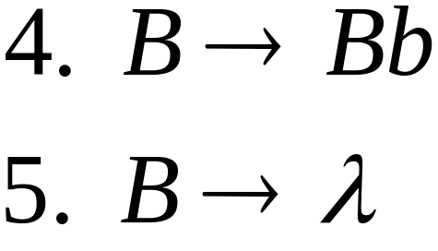
Derivation Order
Consider the following example grammar
with 5 productions:
Fall 2006
Costas Busch - RPI

Slide 29
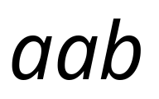

Leftmost derivation order of string :
At each step, we substitute the
leftmost variable
Fall 2006
Costas Busch - RPI

Slide 30

Rightmost derivation order of string :
At each step, we substitute the
rightmost variable
Fall 2006
Costas Busch - RPI

Slide 31
Leftmost derivation of :
Rightmost derivation of :
Fall 2006
Costas Busch - RPI

Slide 32

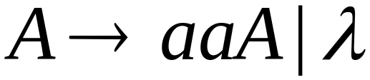
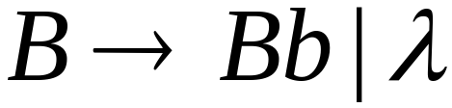
Derivation Trees
Consider the same example grammar:
And a derivation of :
Fall 2006
Costas Busch - RPI

Slide 33




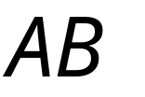
yield
Fall 2006
Costas Busch - RPI

Slide 34

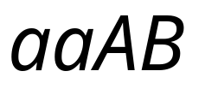

yield
Fall 2006
Costas Busch - RPI

Slide 35

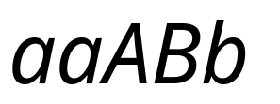
yield
Fall 2006
Costas Busch - RPI

Slide 36

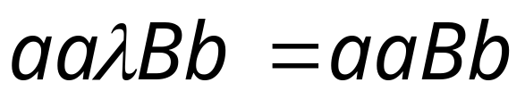
yield
Fall 2006
Costas Busch - RPI

Slide 37
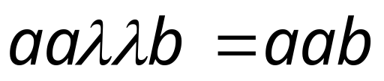
Derivation Tree
(parse tree)
yield
Fall 2006
Costas Busch - RPI

Slide 38
Sometimes, derivation order doesn’t matter
Leftmost derivation:
Rightmost derivation:
Give same
derivation tree
Fall 2006
Costas Busch - RPI

Slide 39
Ambiguity
Fall 2006
Costas Busch - RPI

Slide 40
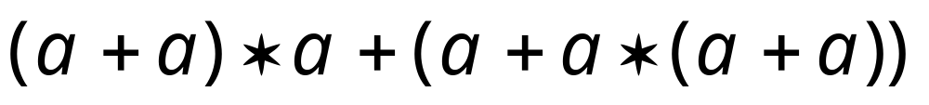
Grammar for mathematical expressions
Example strings:
Denotes any number
Fall 2006
Costas Busch - RPI

Slide 41





A leftmost derivation
for
Fall 2006
Costas Busch - RPI

Slide 42

Another
leftmost derivation
for
Fall 2006
Costas Busch - RPI

Slide 43
Two derivation trees
for
Fall 2006
Costas Busch - RPI

Slide 44

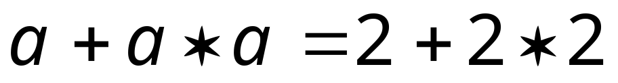

take
Fall 2006
Costas Busch - RPI

Slide 45





Good Tree
Bad Tree
Compute expression result
using the tree
Fall 2006
Costas Busch - RPI

Slide 46
Two different derivation trees
may cause problems in applications which
use the derivation trees:
Evaluating expressions
In general, in compilers
for programming languages
Fall 2006
Costas Busch - RPI

Slide 47

Ambiguous Grammar:
A context-free grammar is ambiguous
if there is a string which has:
two different derivation trees
or
two leftmost derivations
(Two different derivation trees give two
different leftmost derivations and vice-versa)
Fall 2006
Costas Busch - RPI

Slide 48
Example:
this grammar is ambiguous since
string
has two derivation trees
Fall 2006
Costas Busch - RPI

Slide 49
this grammar is ambiguous also because
string
has two leftmost derivations
Fall 2006
Costas Busch - RPI

Slide 50

Another ambiguous grammar:
IF_STMT
if EXPR then STMT
if EXPR then STMT else STMT
Variables
Terminals
Very common piece of grammar
in programming languages
Fall 2006
Costas Busch - RPI

Slide 51
If expr1 then if expr2 then stmt1 else stmt2
IF_STMT
if
expr1
then
STMT
if
expr2
then
stmt1
else
stmt2
Two derivation trees
IF_STMT
if
expr1
then
STMT
else
stmt2
if
expr2
then
stmt1
Fall 2006
Costas Busch - RPI

Slide 52
In general, ambiguity is bad
and we want to remove it
Sometimes it is possible to find
a non-ambiguous grammar for a language
But, in general we cannot do so
Fall 2006
Costas Busch - RPI

Slide 53
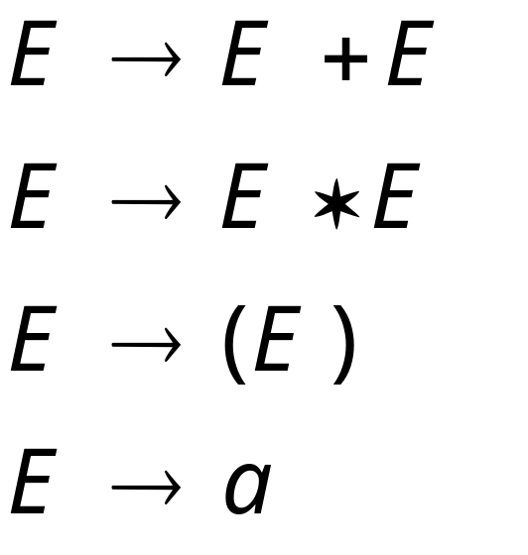
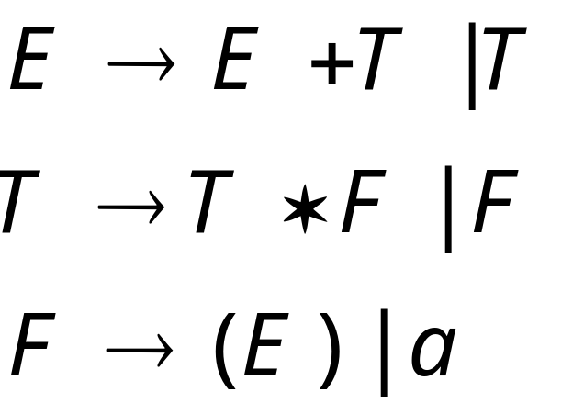
A successful example:
Equivalent
Ambiguous
Grammar
Non-Ambiguous
Grammar
generates the same
language
Fall 2006
Costas Busch - RPI

Slide 54

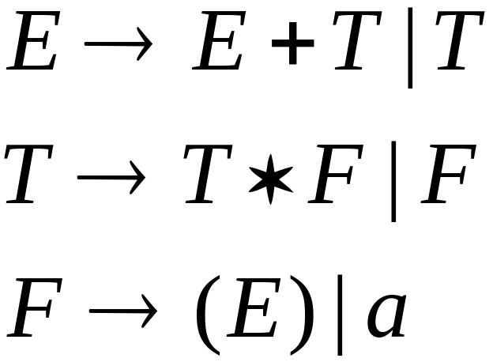


Unique
derivation tree
for
Fall 2006
Costas Busch - RPI

Slide 55
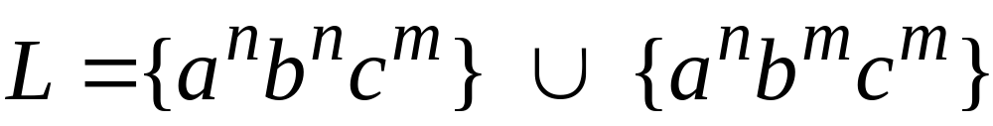


An un-successful example:
is inherently ambiguous:
every grammar that generates this
language is ambiguous
Fall 2006
Costas Busch - RPI

Slide 56


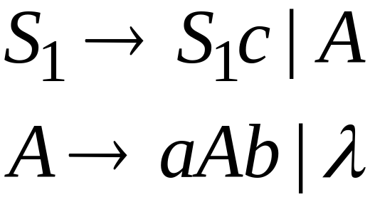
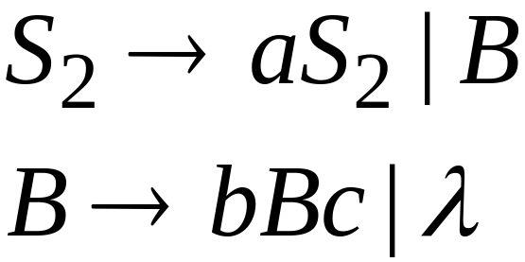
Example (ambiguous) grammar for :
Fall 2006
Costas Busch - RPI

Slide 57
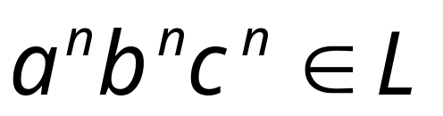



The string
has always two different derivation trees
(for any grammar)
For example
Fall 2006
Costas Busch - RPI

